Slide 1


Introduction to Time Series Analysis
Fondren Library
Digital Scholarship Services

Slide 2
WHAT ARE TIME SERIES?
Simply, data that are collected in a certain order
Evenly or unevenly spaced
Any number of variables

Slide 3
WHAT’S SO SPECIAL ABOUT TIME?
Many statistical models depend upon data points being independent
Linear Regression
Logistic Regression
Many more!
With time series, this basic assumption underlying the entire model can be wrong!
Disastrous results

Slide 4
WHY IS THIS IMPORTANT?
Time series are extremely useful for forecasting
Weather
Stocks (although this is very hard!)
Sports predictions
Election predictions
Well suited to a wide class of problems

Slide 5
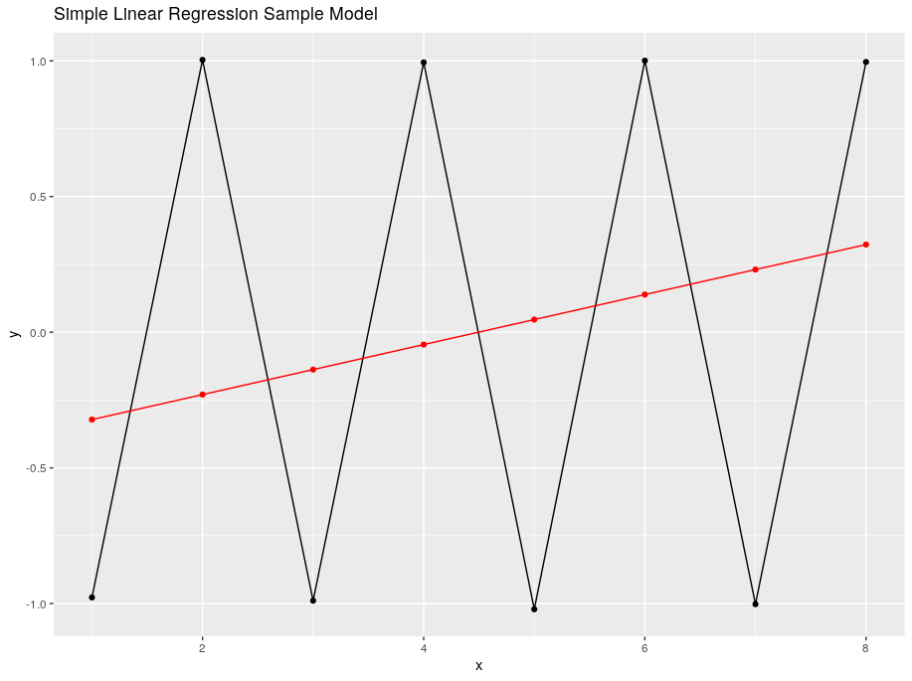
ONE QUICK EXAMPLE
Simple Linear Regression vs. a Time Series Model (ARIMA)

Slide 6
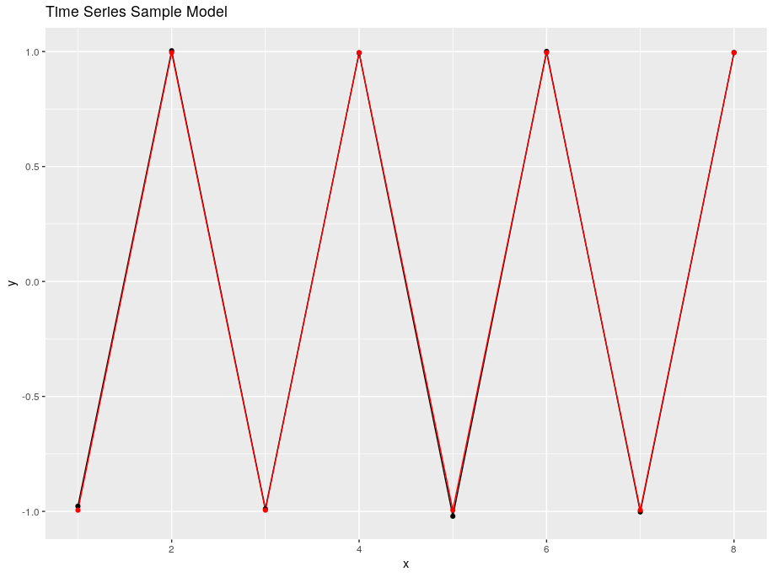
ONE QUICK EXAMPLE
Simple Linear Regression vs. a Time Series Model (ARIMA)

Slide 7
TRENDS AND SEASONALITY
How to filter out the noise and model what really matters

Slide 8
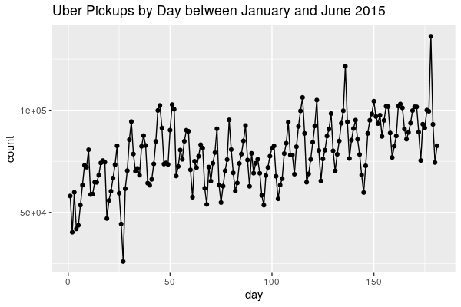
A SAMPLE TIME SERIES

Slide 9
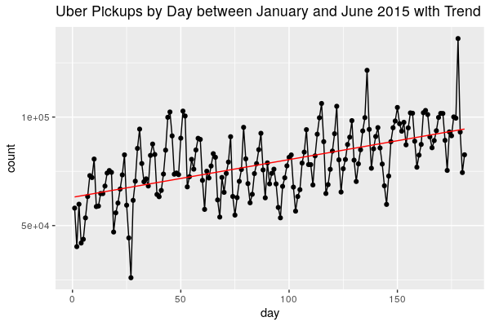
TRENDS

Slide 10
PERIODIC COMPONENTS
Cycles that repeat
Commonly by month, day of week, day of year, etc.

Slide 11
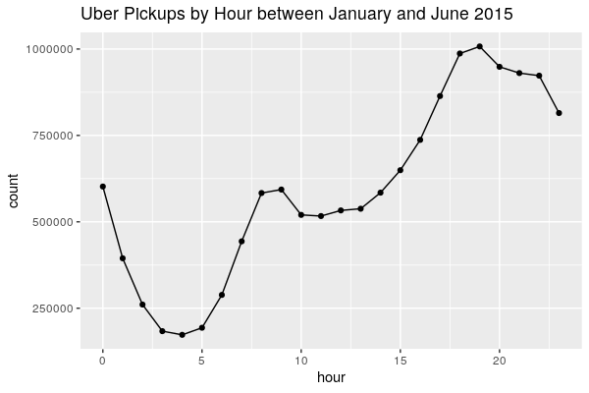
BY HOUR OF DAY

Slide 12
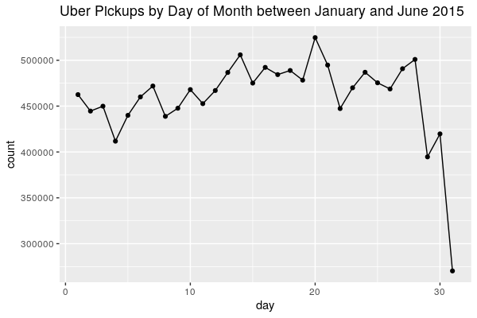
BY DAY OF MONTH

Slide 13
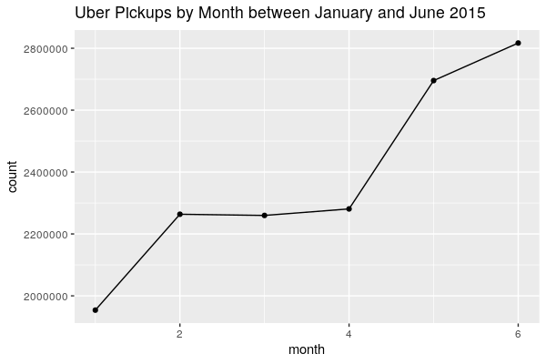
BY MONTH

Slide 14
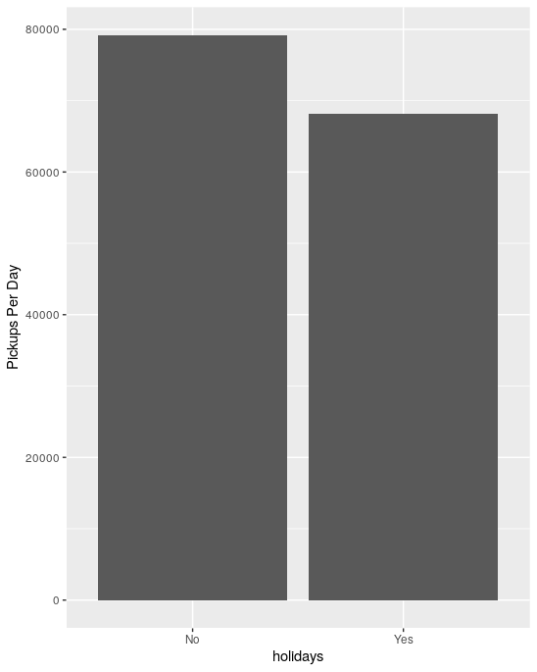
HOLIDAYS

Slide 15
LOOKING BACK AT IT

Slide 16
WHITE NOISE
Not very easy to quantify, but the assumption is that there is some randomness we haven’t accounted for
The statistician’s approach: assume this randomness behaves nicely so we can build some great models!

Slide 17
HOW TO MAKE YOUR DATA STATIONARY
Make your data appetizing for modeling

Slide 18
WHAT IS STATIONARY DATA?
Intuitively, it doesn’t matter where you are in the series
If it’s Monday or Friday, you can model it the same way

Slide 19
DETRENDING
Subtracting our estimate of the data looking at trend only

Slide 20
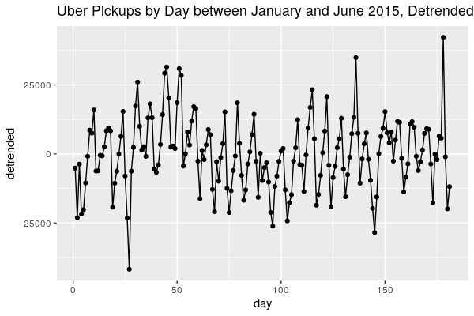
DETRENDING EXAMPLE
Subtracting our estimate of the data looking at trend only

Slide 21
DETRENDING
Subtracting our estimate of the data looking at trend only
But where do we get the trend from?
We have to estimate it ourselves!
What kind of trend is it? Trends don’t have to be linear!
Something else that could go wrong…
Can we do better?

Slide 22
DIFFERENCING
Subtracting values separated by some constant value
If there’s a linear trend, first order differencing will get rid of it!
You can do higher orders for quadratic trends, etc
Also, used for removing some cyclic effects
Weekly cycle? Difference by 7!
Can do many of these at once

Slide 23
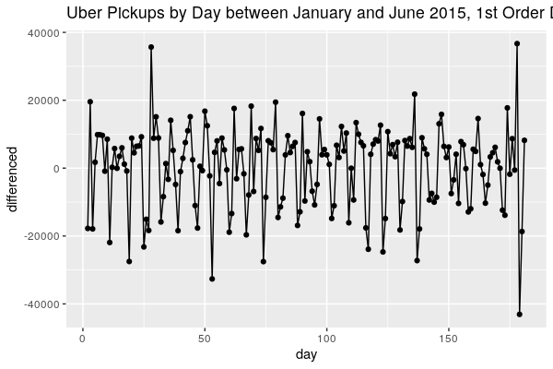
DIFFERENCING EXAMPLE: 1st ORDER

Slide 24
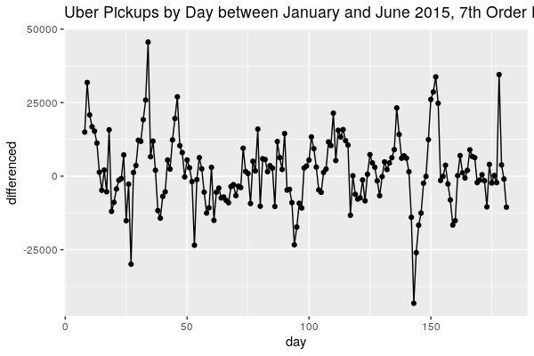
DIFFERENCING EXAMPLE: 7th ORDER

Slide 25
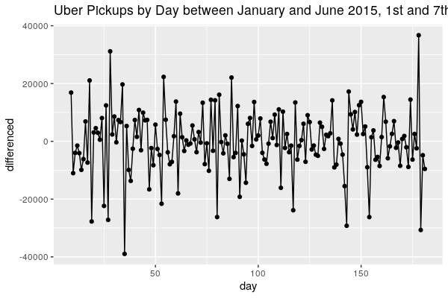
DIFFERENCING EXAMPLE: BOTH!

Slide 26
LAGGED SCATTERPLOTS
How do you know what orders are likely to help?
Lagged scatterplots!
Essentially, plotting one point versus a previous point
If there’s an obvious trend (either positive or negative) it’s probably a good idea to try differencing!

Slide 27
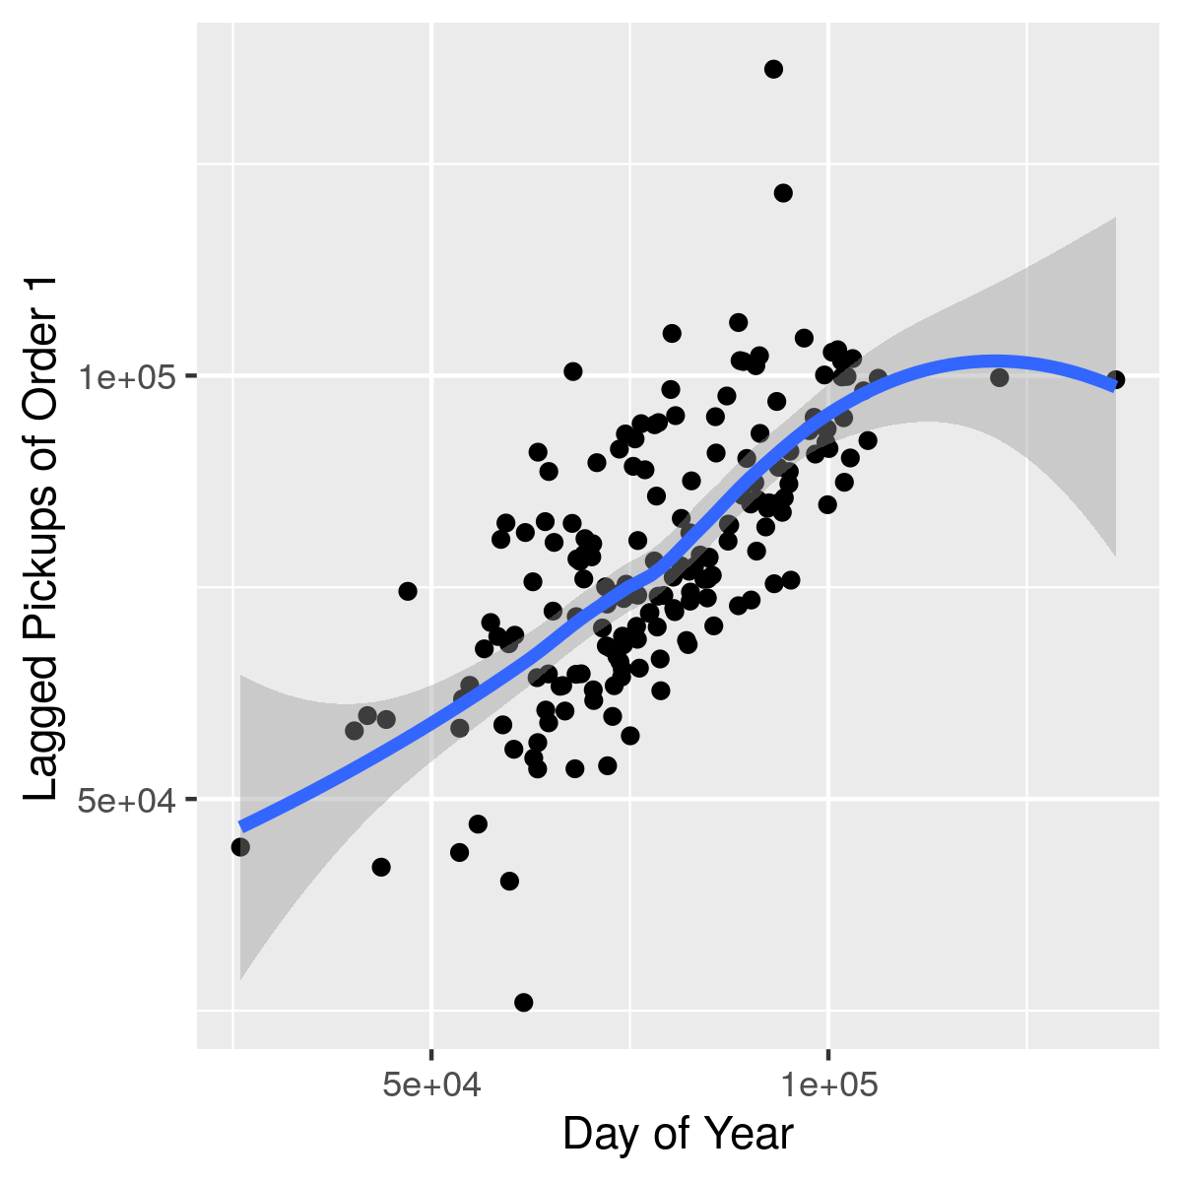
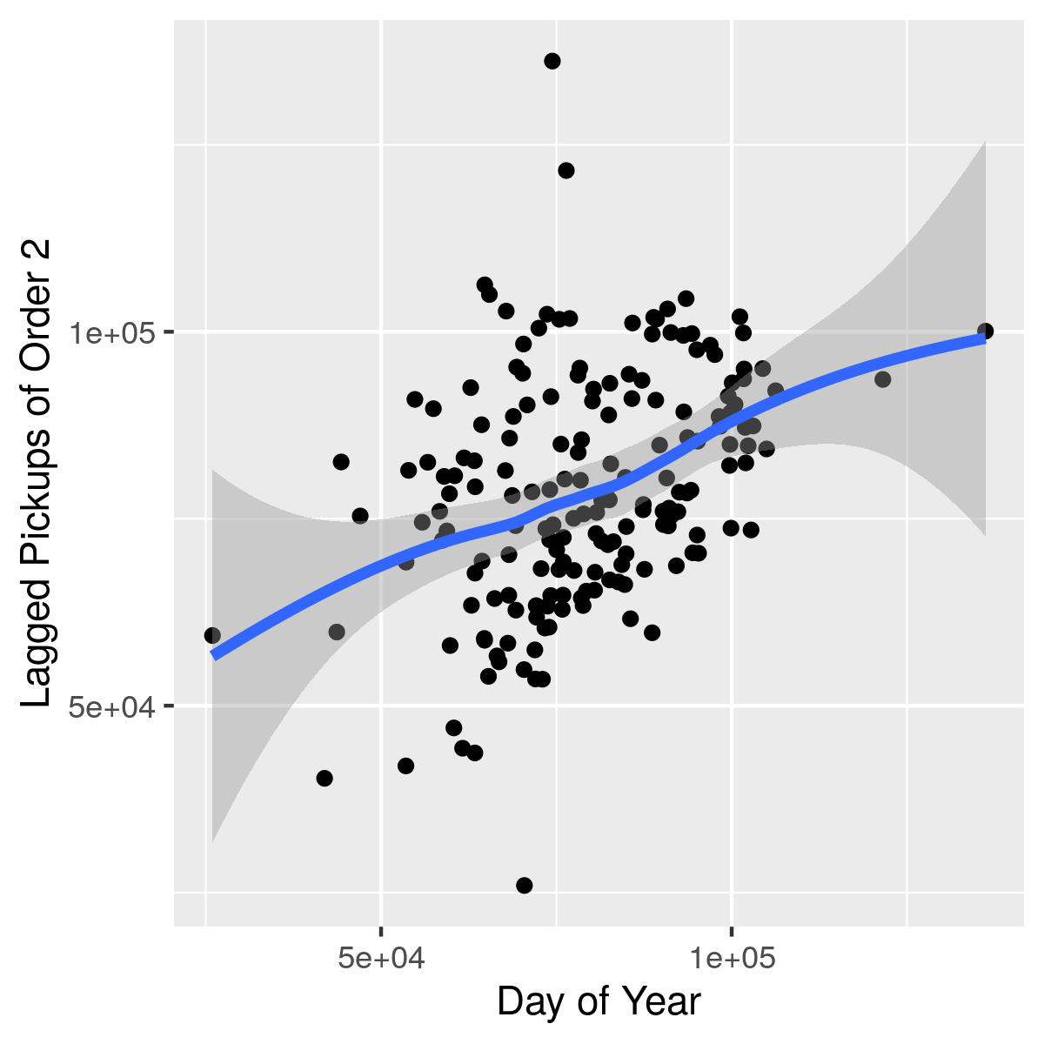
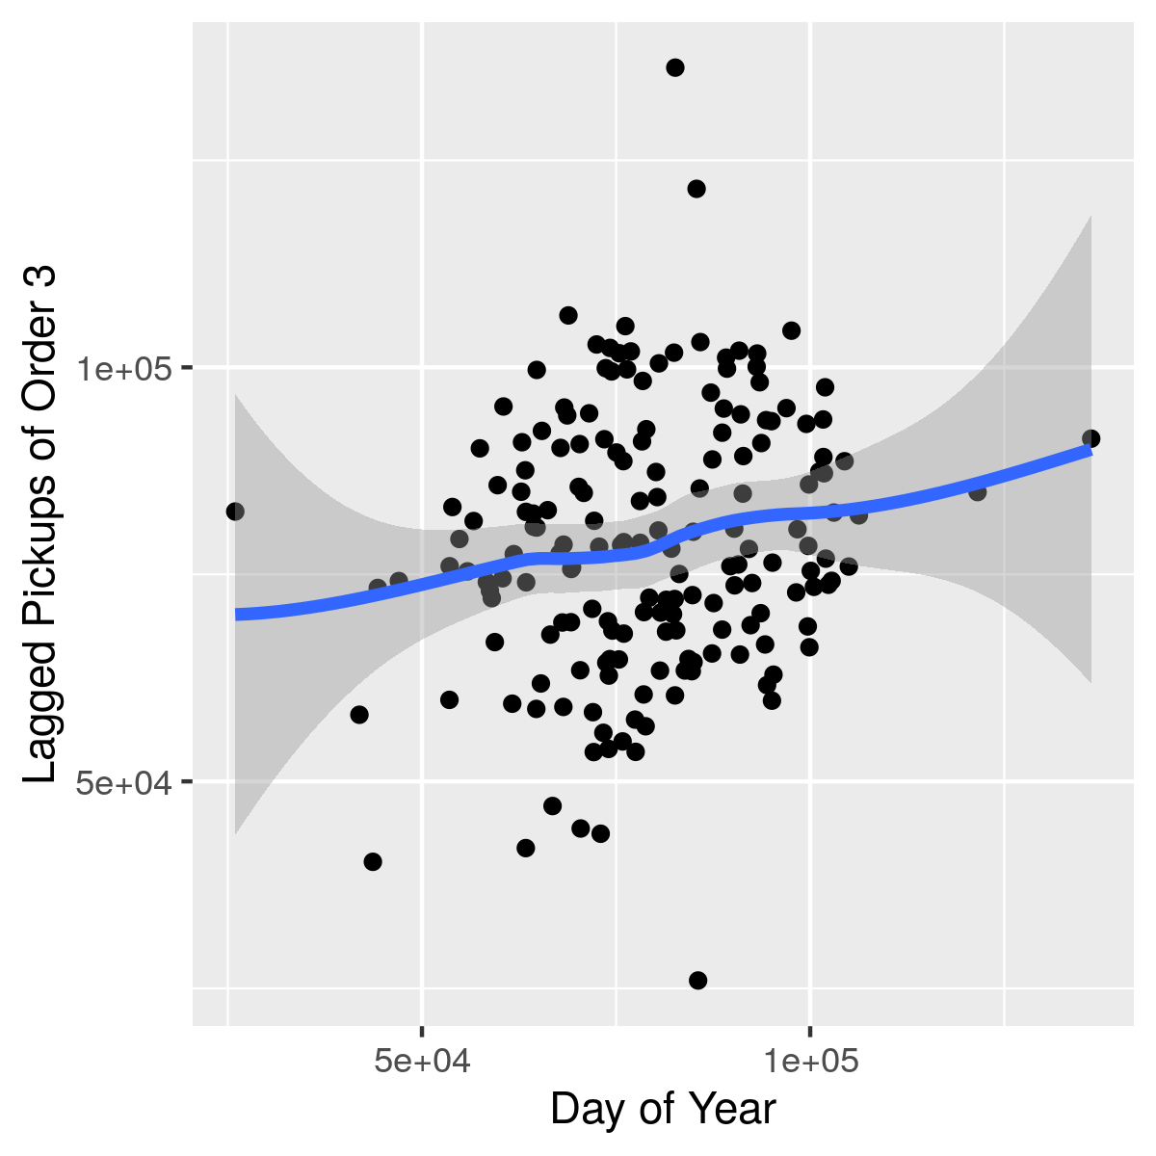
LAGGED SCATTERPLOTS EXAMPLE

Slide 28
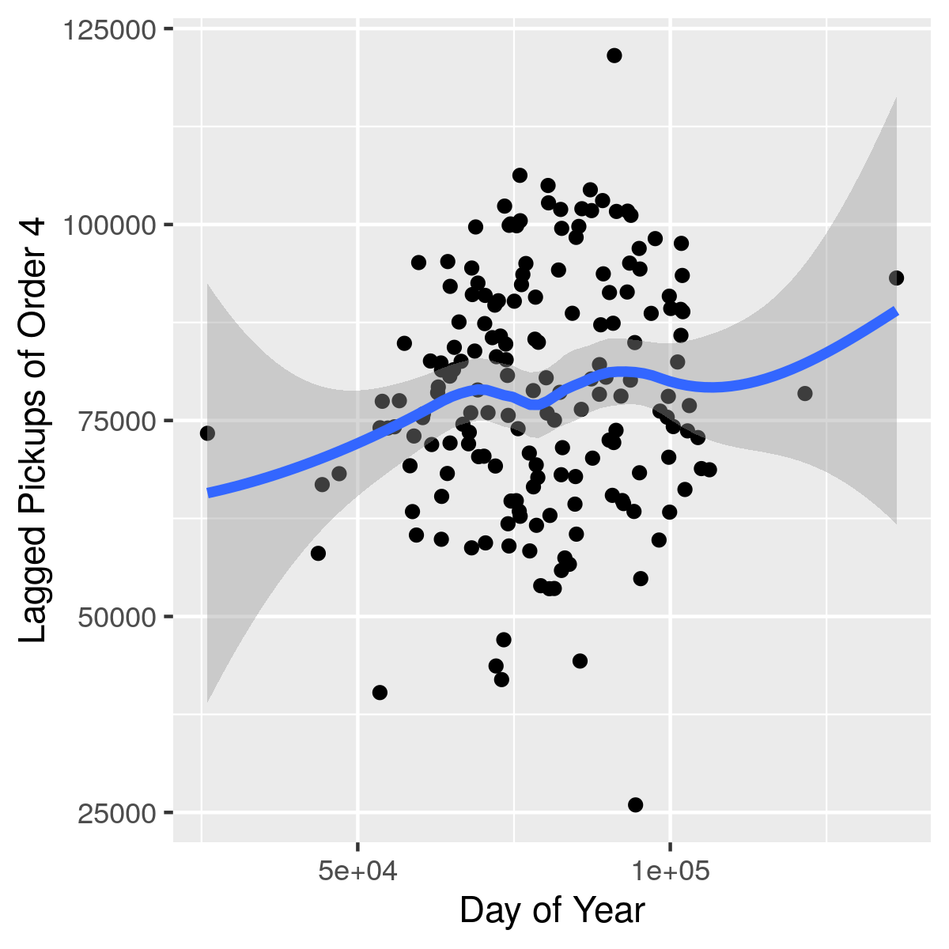
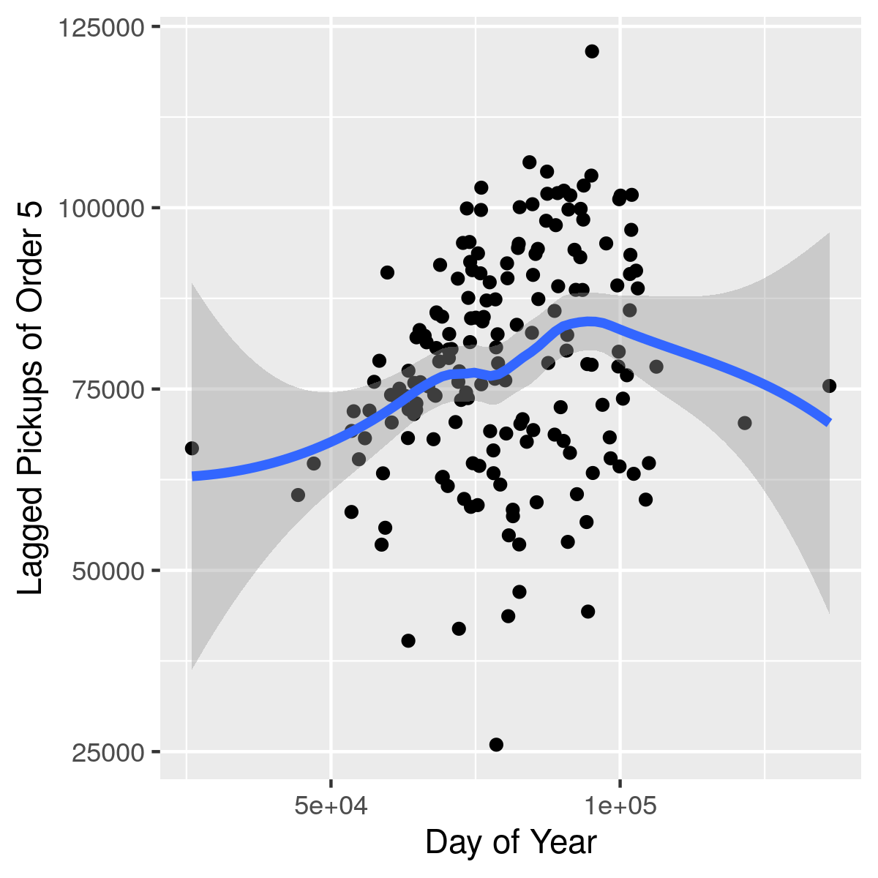
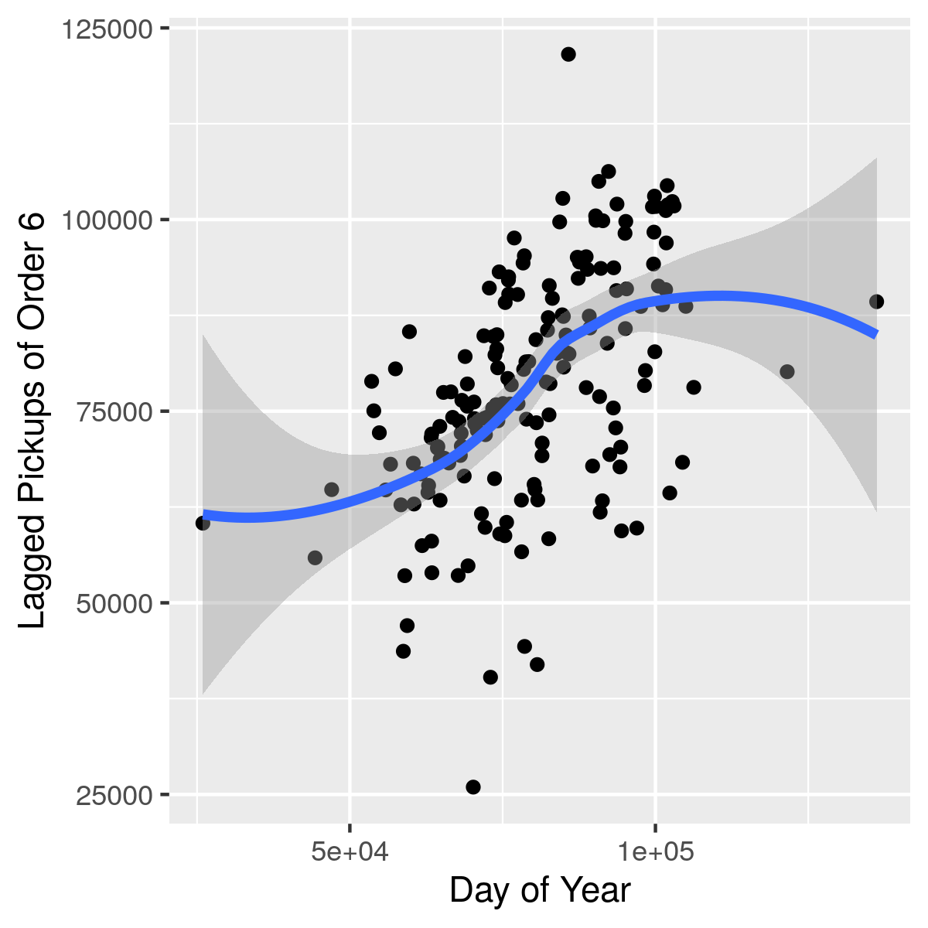
LAGGED SCATTERPLOTS EXAMPLE

Slide 29
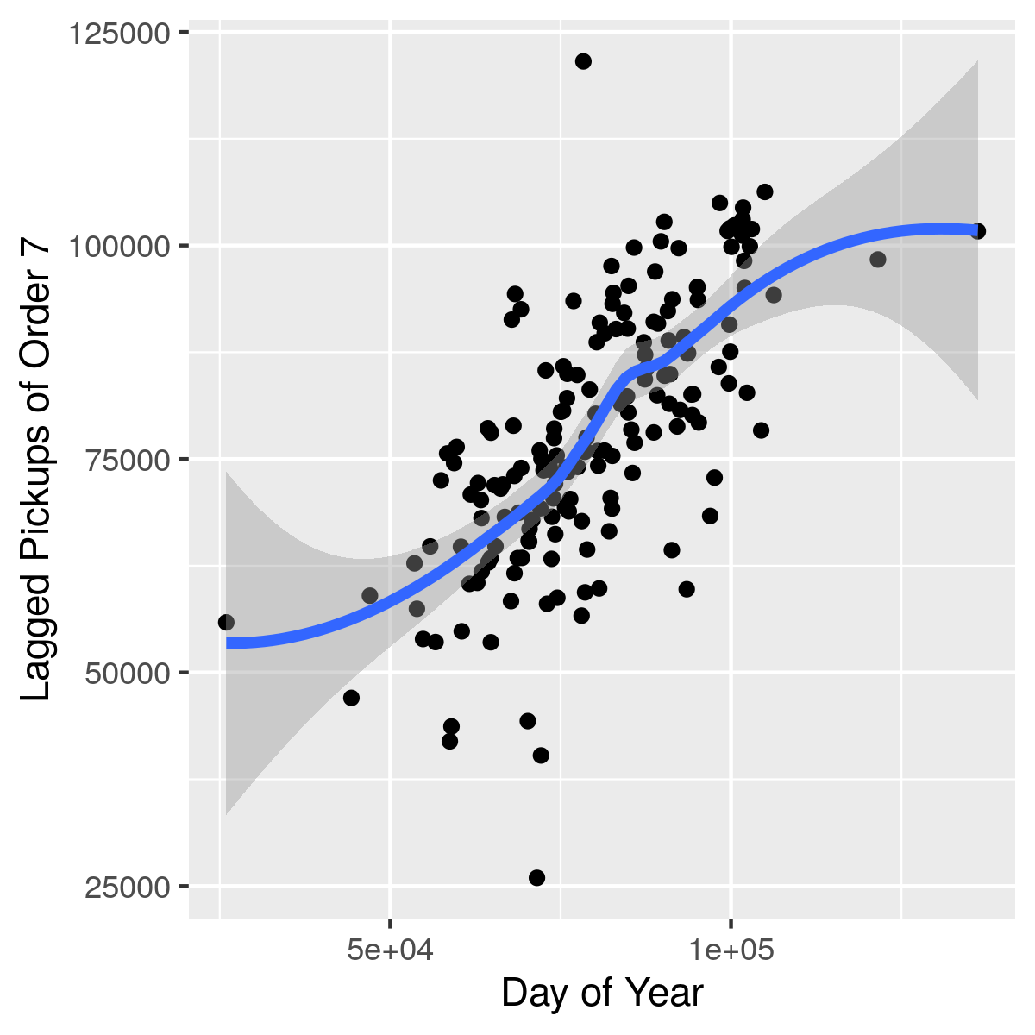
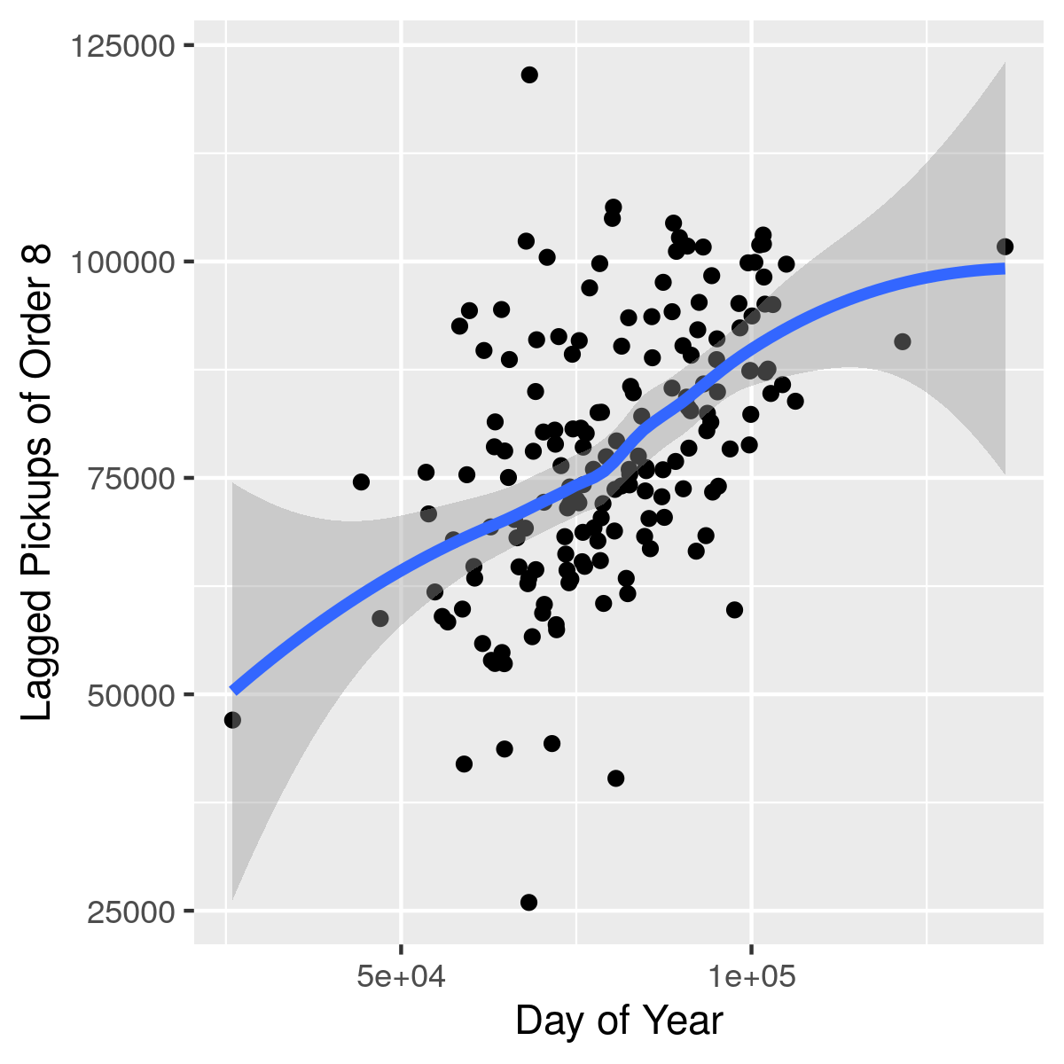
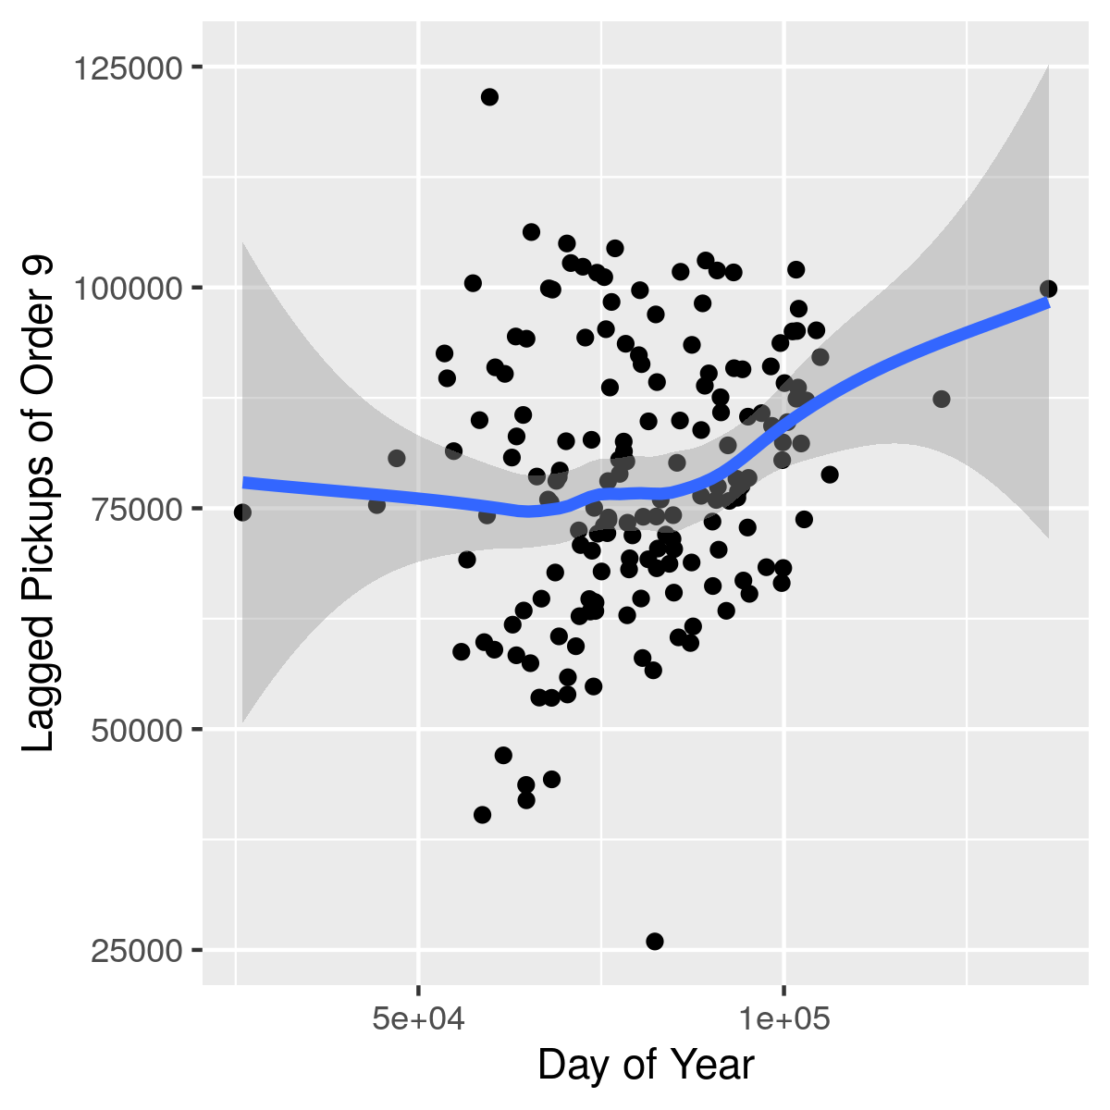
LAGGED SCATTERPLOTS EXAMPLE

Slide 30
ARIMA MODELS
Interpretable, simple and speedy time series modeling

Slide 31
ARIMA MODELS
Auto-Regressive Integrated Moving Average models
Pros:
Great at producing flexible models, solid support of periodic behavior and trending
Parameters are fairly easy to interpret
Widely used and mathematically well-understood
Cons:
Bit of a pain to figure out the right parameters
Not great at dealing with holidays, etc

Slide 32
AUTOREGRESSIVE

Slide 33
MOVING AVERAGE

Slide 34
AUTOCORRELATION PLOTS

Slide 35
PARTIAL AUTOCORRELATION PLOTS

Slide 36
PLAYING AROUND WITH ARIMA

Slide 37
PROPHET MODELS
Facebook’s in-house forecasting tool

Slide 38
PROPHET MODELS
Cutting up a forecast
Pros:
Fast and scalable
Parameters are very easy to understand
Deals with holidays very elegantly
Splitting models up allows even more flexibility
Performs quite well! Results often better than ARIMA
Cons:
Not as widely used (released in Sept. 2017)!
The jury’s still out on this one

Slide 39
NEURAL NETWORK APPROACHES
Breaking out the big guns

Slide 40
NEURAL NETWORK MODELS
Incomprehensible but extremely powerful
Pros:
Often extremely accurate
Cons:
More or less impossible to understand what any of the parameters mean
Can take a very long time to train the model
Lots of moving parts and things that can go wrong
But depending on the problem, that one pro may outweigh all the cons

Slide 41
ACKNOWLEDGMENTS
Plots were created using the ggplot2 package in R
Shumway and Stoffer’s Time Series Analysis and Its Applications With R Examples, Fourth Edition published by Springer was used as the main reference for the ARIMA section
Forecasting at Scale by Sean J. Taylor and Benjamin Letham at Facebook was used as the main reference for the Prophet section

